Slide 1


<Randeep S Dosanjh (Randy)>
<2014-08-18>

Slide 2

Outline
Executive Summary
Introduction
Methodology
Results
Conclusion
Appendix

Slide 3
Executive Summary
Summary of methodologies
Data Collection through API
Data Collection with Web Scraping
Data Wrangling
Exploratory data analysis using SQL
Exploratory data analysis understanding Data Visualization
Interactive visual analytics using Folium
Machine Learning Prediction
Summary of all results
Exploratory Data Analysis result
Interactive analytics in screenshots
Predictive Analytics result

Slide 4
Introduction
Project background and context
With the recent successes in private space travel, space industry is becoming accessible. Cost of launch continues to remain a competitive advantage against competitors who want enter the space race
SpaceX with its first stage reuse capabilities offers a key advantage against its competitors. SpaceX launch costs is about 62 million dollars & SpaceX can reuse stage 1 for future launches to allow for SpaceX to have a competitive advantage.
Problems you want to find answers
How to determine a successfully landing.
What effect do various variables have on the landings.
What operating conditions are required to ensure a successful landings.
Understand how launch sites can effect success rates

Slide 5

Section 1

Slide 6
Methodology
Executive Summary
Data collection methodology:
SpaceX API
Web scrap Falcon 9 and Falcon Heavy launch records from Wikipedia
Wikipedia URL: https://en.wikipedia.org/wiki/List_of_Falcon_9_and_Falcon_Heavy_launches
Perform data wrangling
Determined labels for training the supervised models by converting mission outcomes in to training labels (0-unsuccessful, 1-successful)
One-hot encoding was applied to categorical features
Perform exploratory data analysis (EDA) using visualization and SQL
Perform interactive visual analytics using Folium and Plotly Dash
Perform predictive analysis using classification models
How to build, tune, evaluate classification models

Slide 7
Data Collection
Describe how data sets were collected:
Request launch & Relevant data
Read .json: Used a .json() function call using python pandas dataframe using .json_normalize() to use on the response data.
Convert new Dataframe to CSV format (to use in later steps/phases)
Sources of Data: SpaceX API & web scraping from Wikipedia
You need to present your data collection process use key phrases and flowcharts
Request Falson9 html page: HTTP GET method
Create BeautifulSoup Object from HTML response for webscraping
Parse the table and convert it to a pandas dataframe on-going analysis.

Slide 8
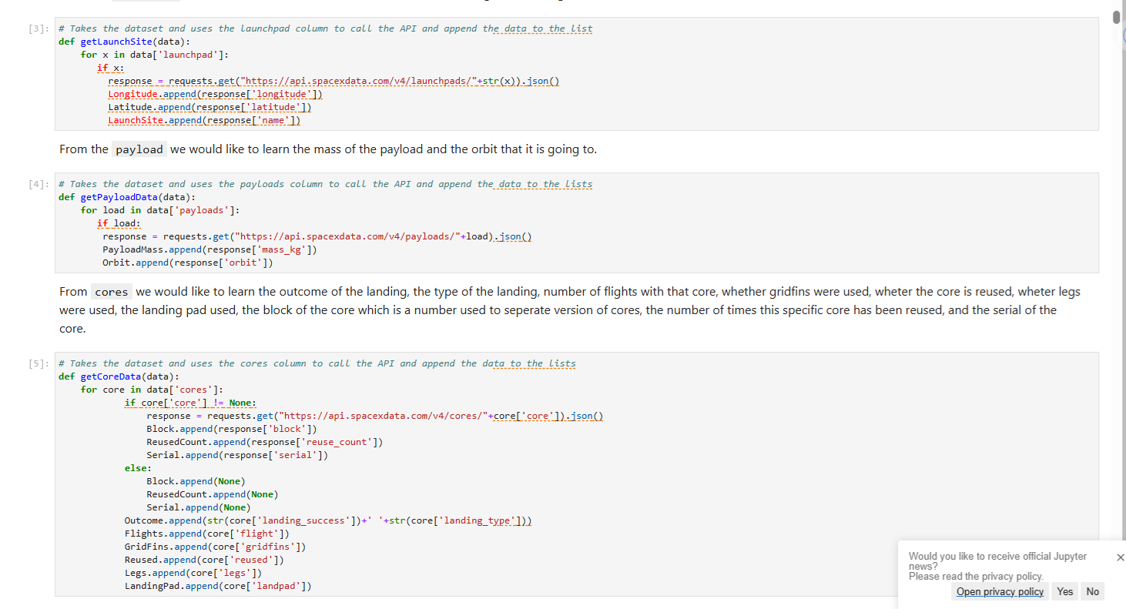
Data Collection – SpaceX API
Data collection with SpaceX REST using key phrases and flowchart presented here with flow or sequence of operations
My GitHub URL of the completed SpaceX API calls found here: as an external reference and peer-review purpose is: ClickstreamConsultingInc/Data-Sci-Capstone-SpaceX: IBM Data Science Professional (github.com),
There was an earlier use of BeautifulSoup with the Python which was key.
Place your flowchart of SpaceX API calls here
Screenshot 1.0

Slide 9
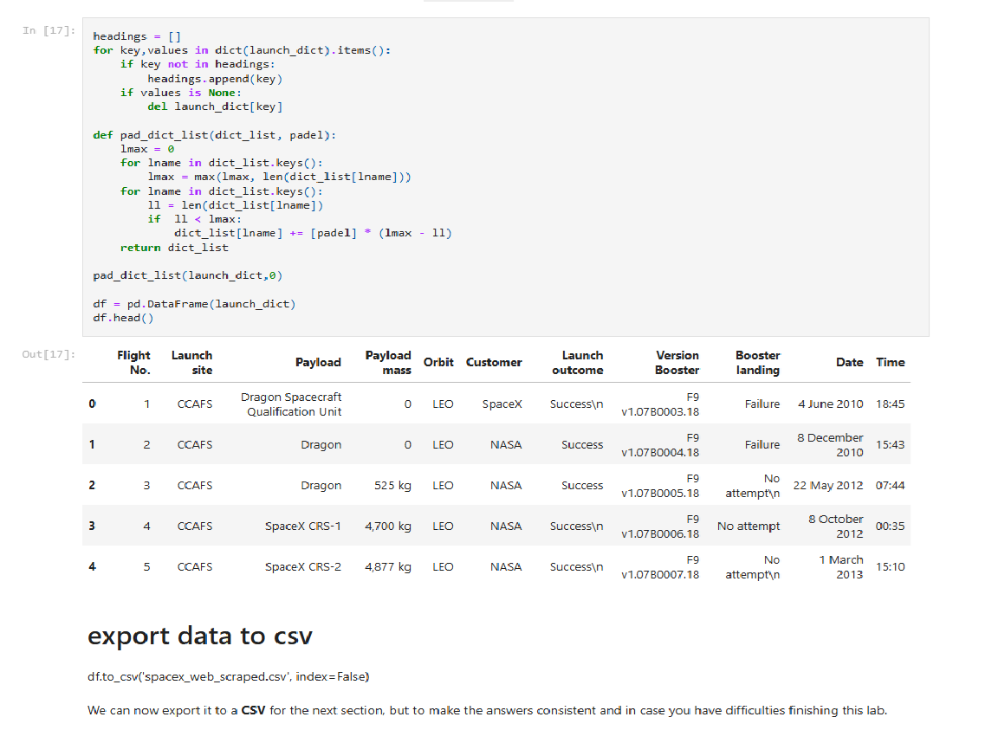
Data Collection - Scraping
This is the code after implementing the correct steps to scrape the data in the table below
My GitHub URL for the completed web scraping notebook, as an external reference and peer-review purpose is: Data-Sci-Capstone-SpaceX/jupyter-labs-webscraping.ipynb at main · ClickstreamConsultingInc/Data-Sci-Capstone-SpaceX (github.com)
Place your flowchart of web scraping here
Screenshot 2.0

Slide 10
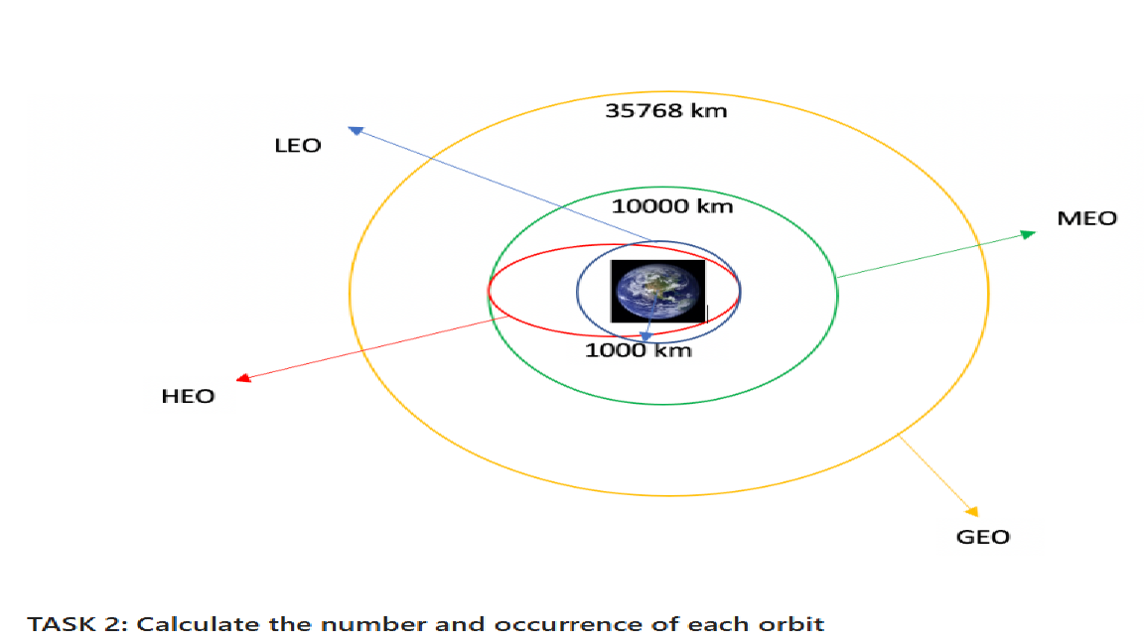
Data Wrangling
First we took a CSV using Panda then, we Identify and calculate the percentage of the missing values in each attribute.
Calculated the number of launches on each site
Add the GitHub URL of my completed data wrangling related notebooks, as an external reference and peer-review purpose is: Data-Sci-Capstone-SpaceX/labs-jupyter-spacex-Data wrangling.ipynb at main · ClickstreamConsultingInc/Data-Sci-Capstone-SpaceX (github.com)
Screenshot 3.0

Slide 11
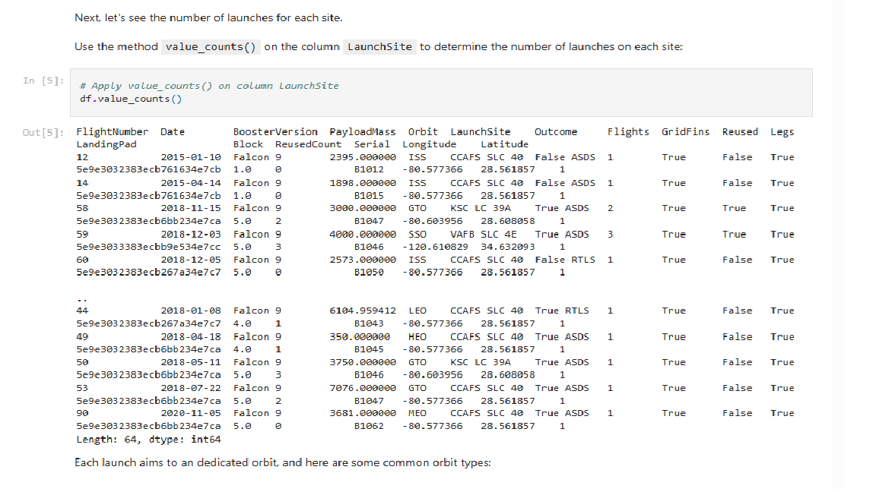
Data Wrangling: Table 1.0
Screenshot 3.1

Slide 12
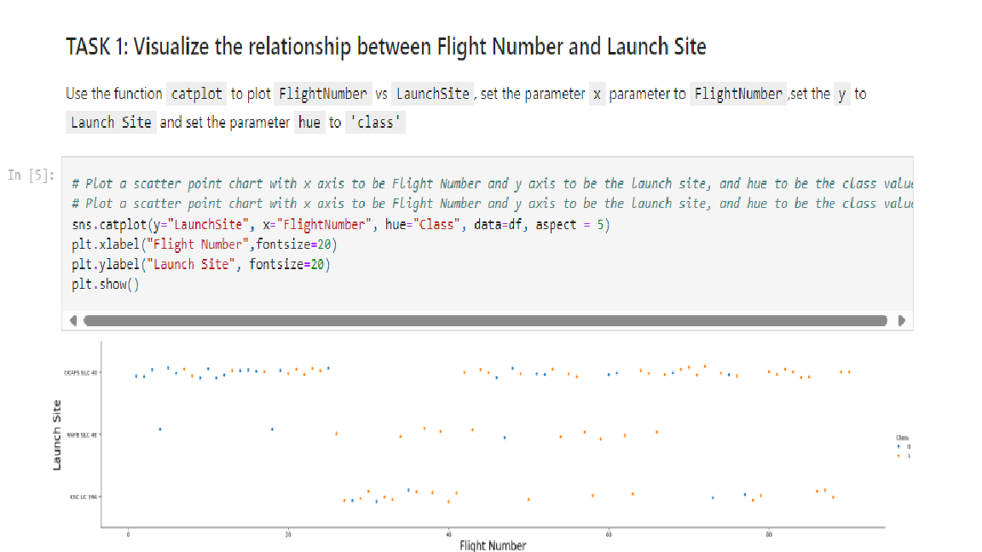
EDA with Data Visualization
Summarize what charts were plotted and why you used those charts
Add the GitHub URL of your completed EDA with data visualization notebook, as an external reference and peer-review purpose
Screenshot 4.0

Slide 13
EDA with SQL: SQL used & at which Task No.
Task-0
#DROP THE TABLE IF EXISTS
%sql DROP TABLE IF EXISTS SPACEXTABLE;
%sql create table SPACEXTABLE as select * from SPACEXTBL where Date is not null
Task-1
%sql SELECT DISTINCT(Launch_SIte) FROM SPACEXTABLE
Task-2
%sql SELECT * FROM SPACEXTABLE WHERE Launch_Site LIKE 'CCA%' LIMIT 15
Task-3
%sql CREATE TABLE T2 AS SELECT SUM(PAYLOAD_MASS__KG_),Customer FROM SPACEXTABLE GROUP BY Customer
%sql SELECT * FROM T1 WHERE Customer = 'NASA (CRS)’
Task-4
#%sql CREATE TABLE T4 AS SELECT SUM(PAYLOAD_MASS__KG_),COUNT(*),Booster_Version FROM SPACEXTABLE GROUP BY Booster_Version
#%sql SELECT * FROM T4
%sql SELECT * FROM T4 WHERE Booster_Version = 'F9 v1.1’
Task-4
#%sql CREATE TABLE T4 AS SELECT SUM(PAYLOAD_MASS__KG_),COUNT(*),Booster_Version FROM SPACEXTABLE GROUP BY Booster_Version
#%sql SELECT * FROM T4
%sql SELECT * FROM T4 WHERE Booster_Version = 'F9 v1.1'
GitHub URL of your completed EDA with SQL notebook, as an external reference and peer-review purpose:
Data-Sci-Capstone-SpaceX/jupyter-labs-eda-sql-coursera_sqllite.ipynb at main · ClickstreamConsultingInc/Data-Sci-Capstone-SpaceX (github.com)

Slide 14
EDA with SQL: SQL used & at which Task No.
Task-5
#%sql CREATE TABLE SUCCES AS SELECT * FROM SPACEXTABLE WHERE Landing_Outcome LIKE 'Controlled%'
%sql SELECT MIN(DATE) FROM SUCCES
Task-6
#%sql CREATE TABLE S AS SELECT * FROM SPACEXTABLE WHERE MISSION_OUTCOME = 'Success'
%sql SELECT Booster_Version FROM S WHERE PAYLOAD_MASS__KG_ >4000 AND PAYLOAD_MASS__KG_ <6000
Task-7
%sql SELECT COUNT(*),Mission_Outcome FROM SPACEXTABLE GROUP BY Mission_Outcome
Task-8
%sql SELECT Booster_Version FROM SPACEXTABLE WHERE PAYLOAD_MASS__KG_ IN (SELECT MAX(PAYLOAD_MASS__KG_ ) FROM SPACEXTABLE)
Task-9
%%sql
SELECT substr(Date, 4, 2) AS Month, Landing_Outcome, Booster_Version, Launch_Site FROM SPACEXTBL
WHERE Landing_outcome = 'Failure (drone ship)'
AND substr(Date, 7, 4) = '2015';
Task-10
%%sql
SELECT Landing_Outcome, COUNT(*) AS Total_Outcomes FROM SPACEXTBL
WHERE substr(Date,7,4) BETWEEN '2010-06-04' AND '2017-03-20'
GROUP BY Landing_Outcome
ORDER BY Total_Outcomes DESC;
GitHub URL of your completed EDA with SQL notebook, as an external reference and peer-review purpose:
Data-Sci-Capstone-SpaceX/jupyter-labs-eda-sql-coursera_sqllite.ipynb at main · ClickstreamConsultingInc/Data-Sci-Capstone-SpaceX (github.com)

Slide 15
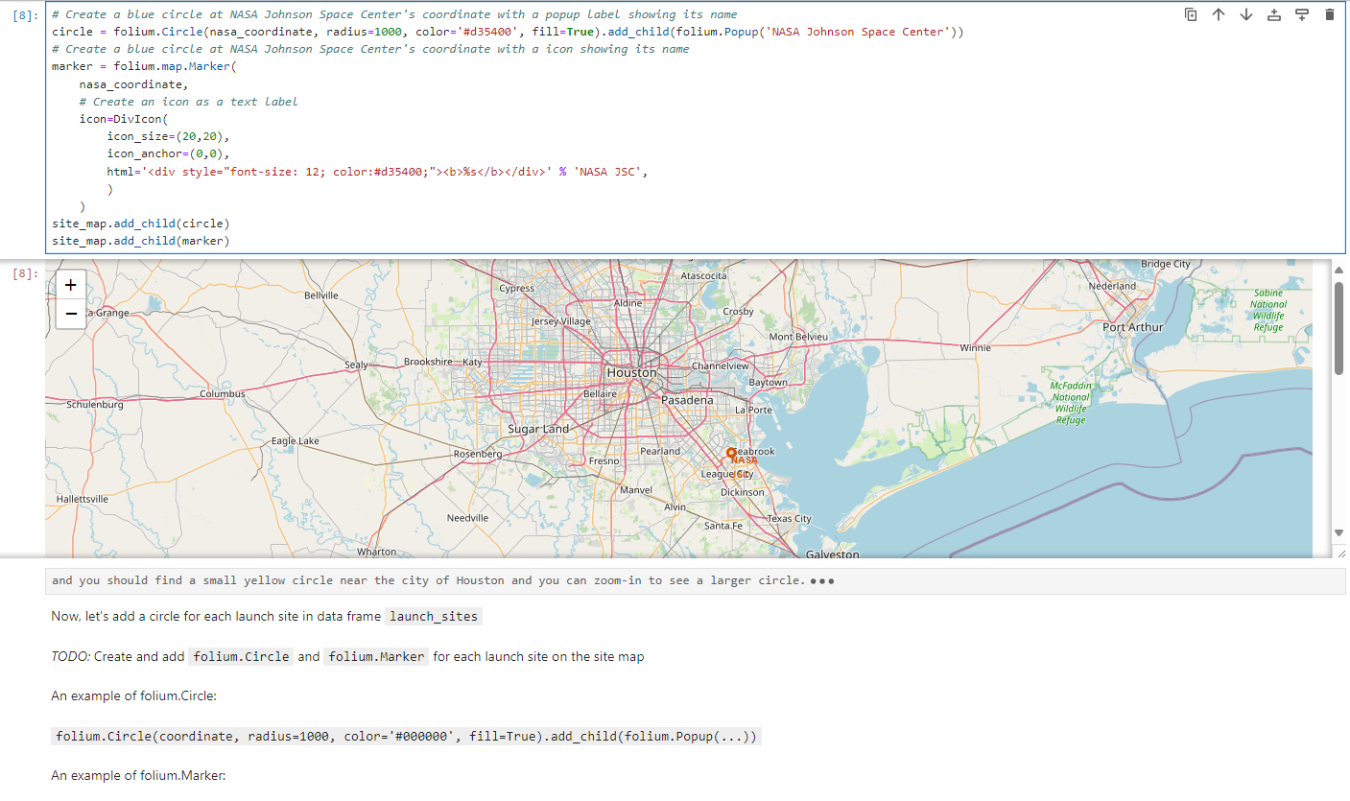
Build an Interactive Map with Folium
Summarize what map objects such as markers, circles, lines, etc. you created and added to a folium map
Screenshot 5.0

Slide 16
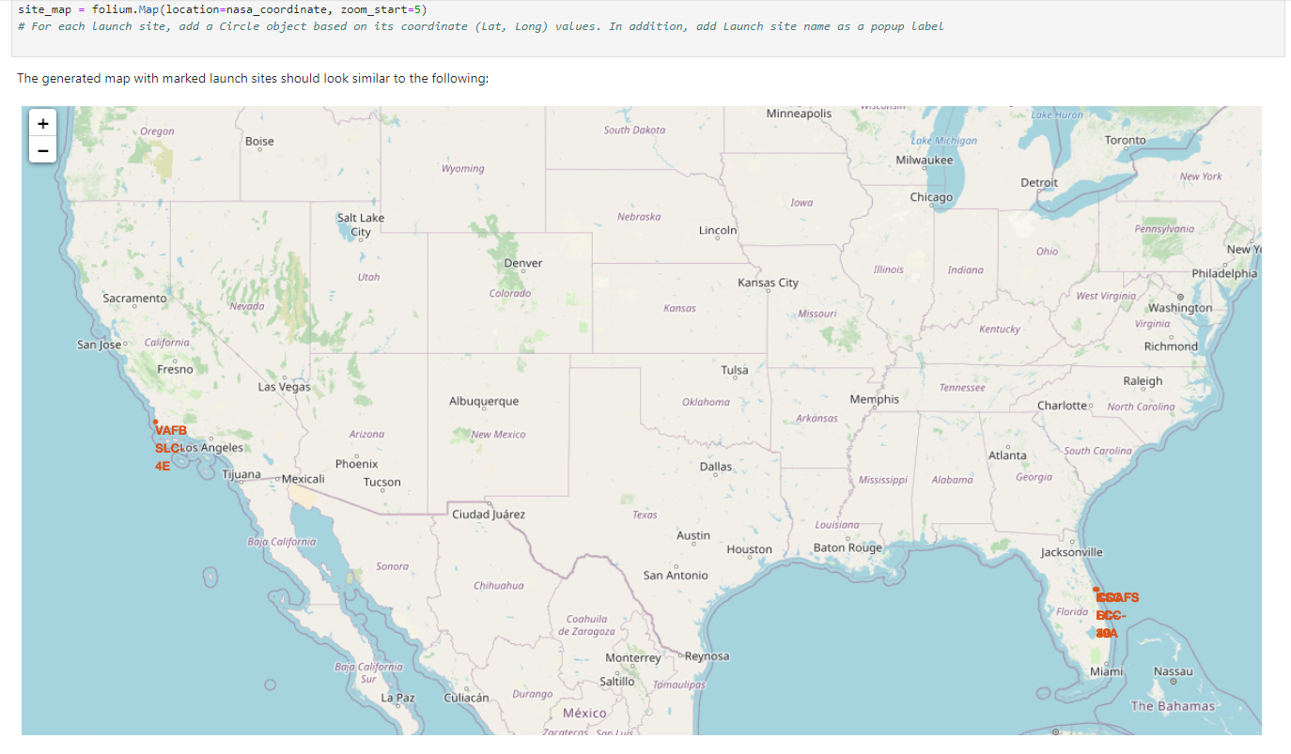
Build an Interactive Map with Folium
Summarize what map objects such as markers, circles, lines, etc. you created and added to a folium map
Screenshot 5.1

Slide 17
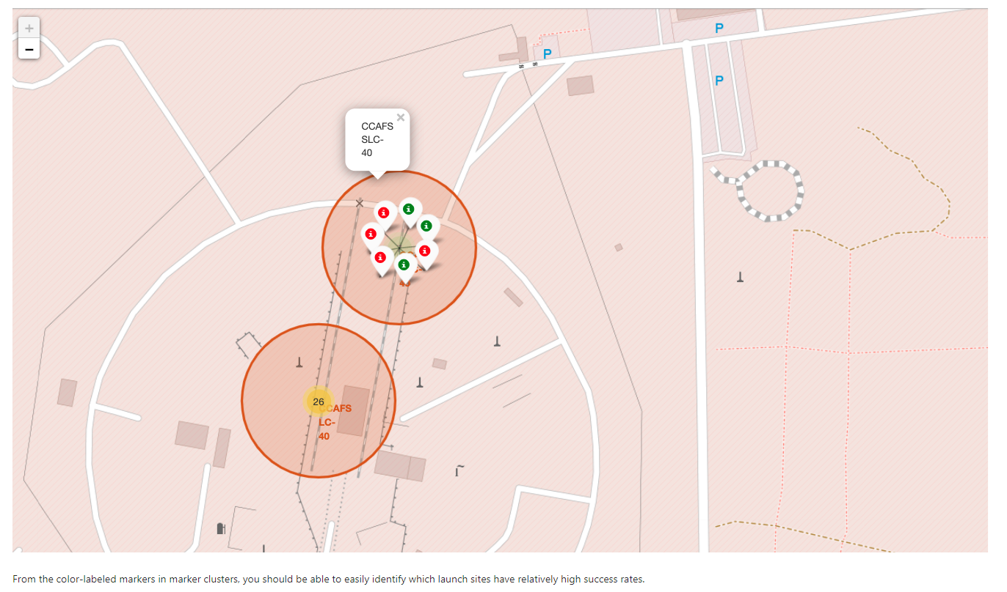
Build an Interactive Map with Folium
Summarize what map objects such as markers, circles, lines, etc. you created and added to a folium map
Screenshot 5.2

Slide 18
Build a Dashboard with Plotly Dash
The general idea of this callback function is to get the selected launch site from site-dropdown and render a pie chart visualizing launch success counts.
Dash callback function is a type of Python function which will be automatically called by Dash whenever receiving an input component updates, such as a click or dropdown selecting event.
The GitHub URL of my completed Plotly Dash lab, as an external reference and peer-review purpose: https://randydosanjh-8050.theianext-0-labs-prod-misc-tools-us-east-0.proxy.cognitiveclass.ai/

Slide 19
Predictive Analysis (Classification)
For both Training and Testing: loaded the data using numpy and pandas
Built built different machine learning models
Improved the model using feature engineering and algorithm tuning.
GitHub URL of completed predictive analysis lab, as an external reference and peer-review purpose: https://github.com/ClickstreamConsultingInc/Data-Sci-Capstone-SpaceX/blob/main/SpaceX_Machine%20Learning%20Prediction_Part_5.ipynb

Slide 20
Summary of Completed Results
Exploratory data analysis results
Interactive analytics demo in screenshots
Predictive analysis results

Slide 21

Section 2

Slide 22
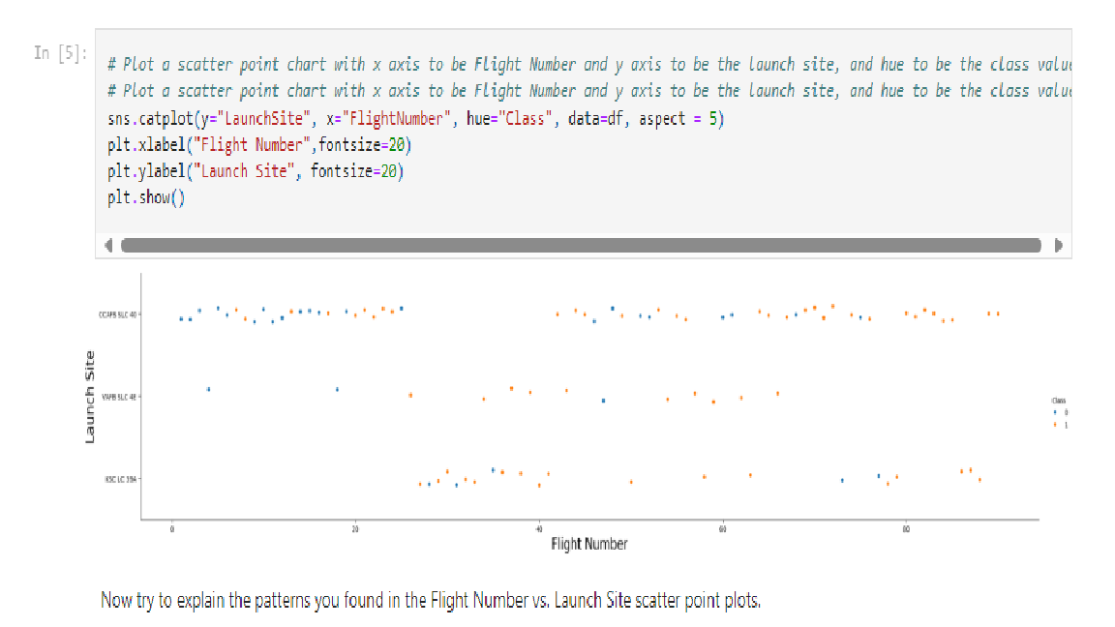
Flight Number vs. Launch Site
Scatter plot of Flight Number vs. Launch Site
Screenshot of the scatter plot with explanations

Slide 23
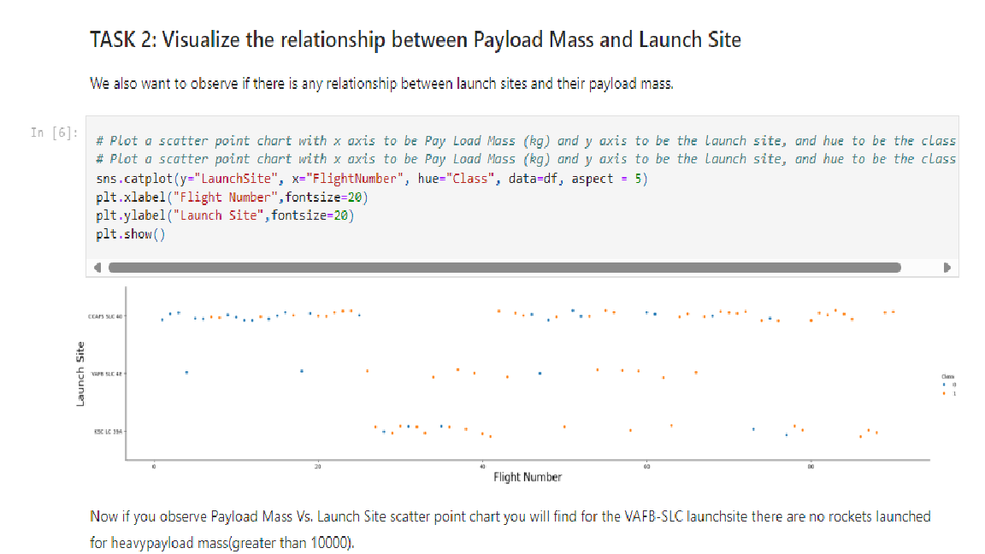
Payload vs. Launch Site
Scatter plot of Payload vs. Launch Site
Screenshot of the scatter plot with explanations

Slide 24
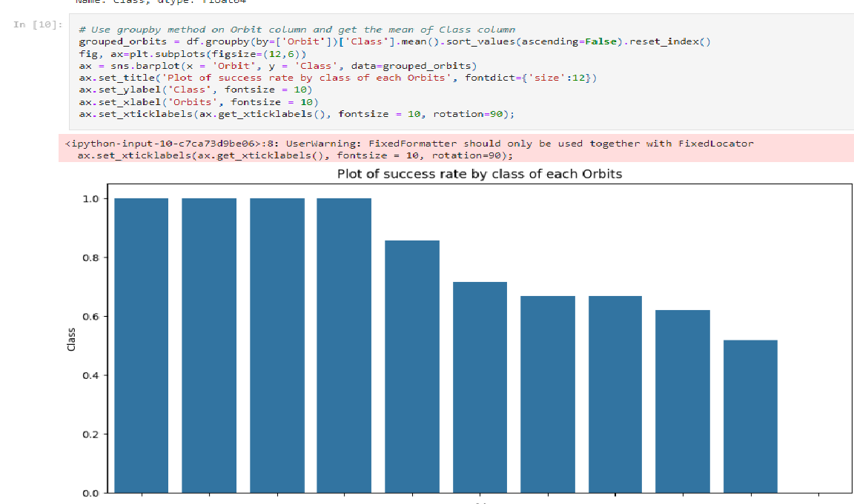
Success Rate vs. Orbit Type
Show a bar chart for the success rate of each orbit type
Show the screenshot of the scatter plot with explanations

Slide 25
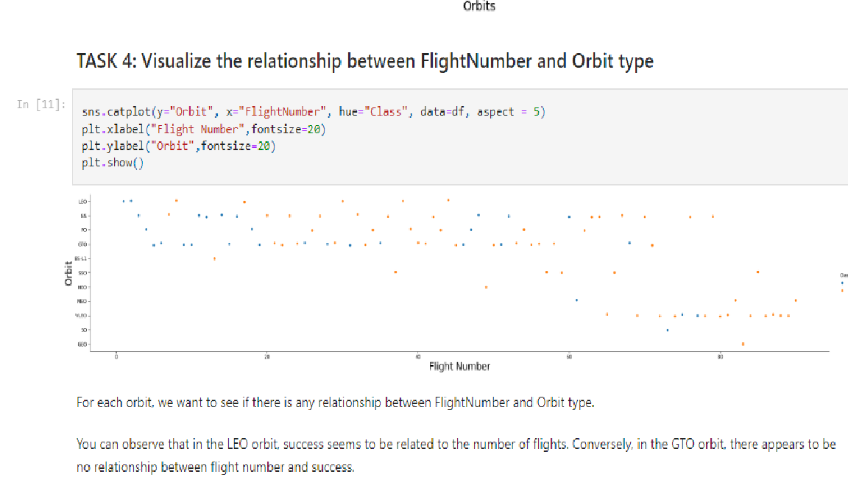
Flight Number vs. Orbit Type
Show a scatter point of Flight number vs. Orbit type
Show the screenshot of the scatter plot with explanations

Slide 26
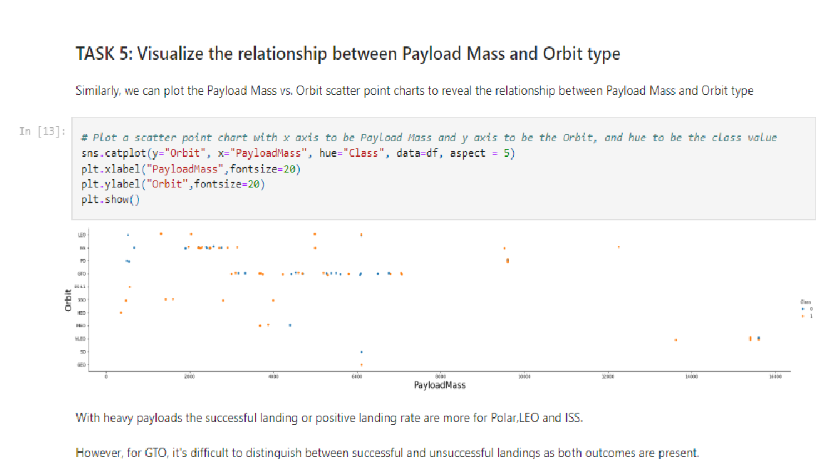
Payload vs. Orbit Type
Show a scatter point of payload vs. orbit type
Show the screenshot of the scatter plot with explanations

Slide 27
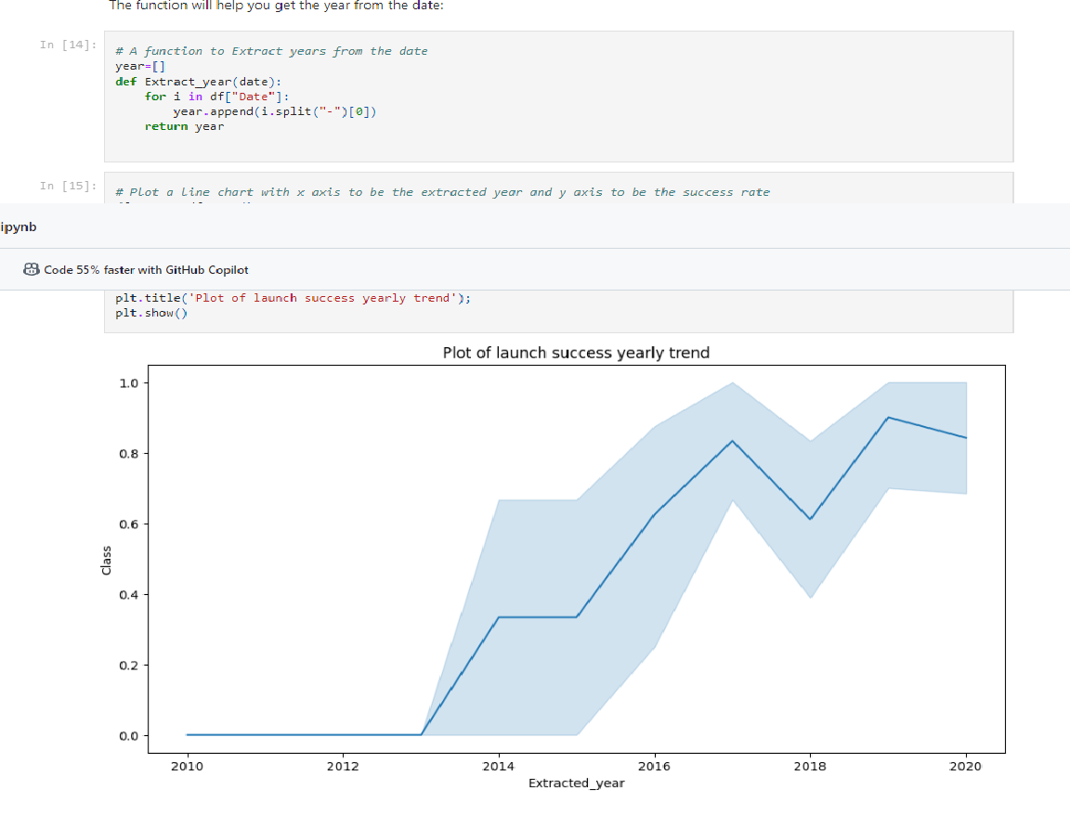
Launch Success Yearly Trend
Show a line chart of yearly average success rate
Show the screenshot of the scatter plot with explanations

Slide 28
All Launch Site Names
Find the names of the unique launch sites
Present your query result with a short explanation here

Slide 29
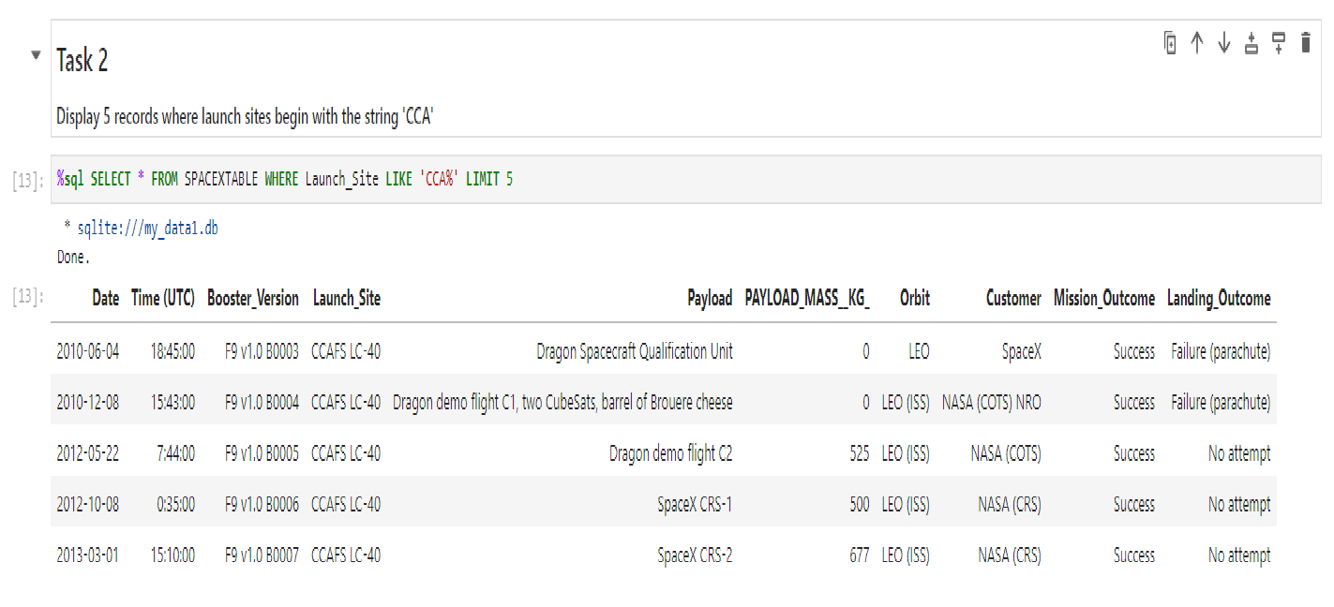
Launch Site Names Begin with 'CCA'
Find 5 records where launch sites begin with `CCA`
Present your query result with a short explanation here

Slide 30
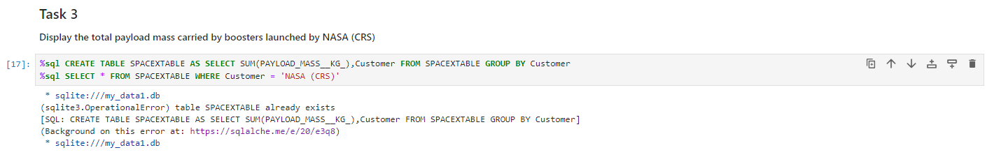
Total Payload Mass
Calculated the total payload carried by boosters from NASA
Presented query result with a short explanation here

Slide 31
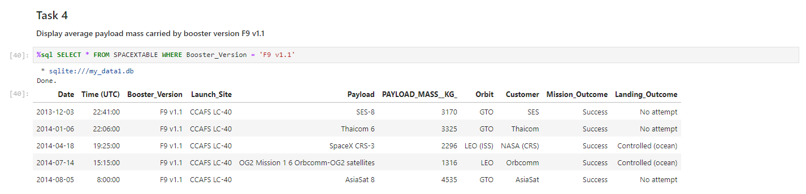
Average Payload Mass by F9 v1.1
Calculated the average payload mass carried by booster version F9 v1.1
Presented query result with a short explanation here

Slide 32
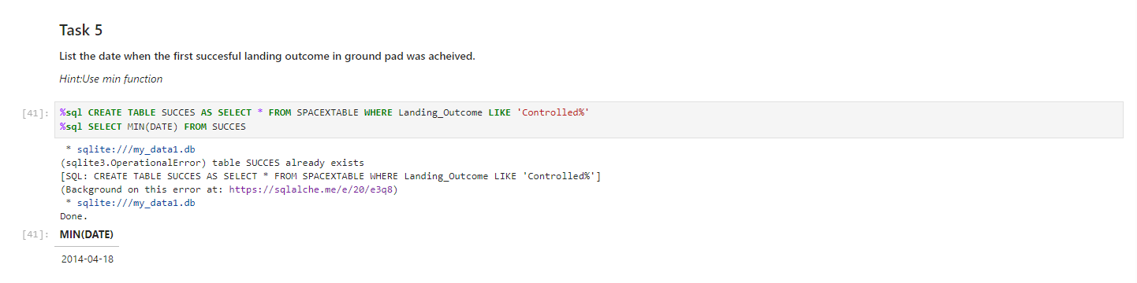
First Successful Ground Landing Date
Date of the first successful landing outcome on ground pad
Presented query result with a short explanation here

Slide 33
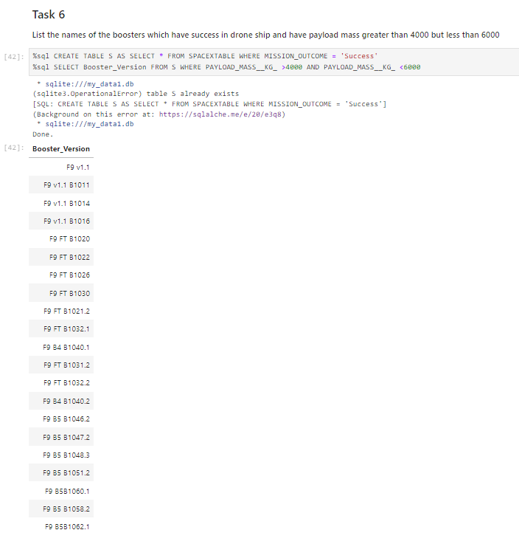
Successful Drone Ship Landing with Payload between 4000 and 6000
Names of boosters which have successfully landed on drone ship and had payload mass greater than 4000 but less than 6000
Presented query result with a short explanation here

Slide 34
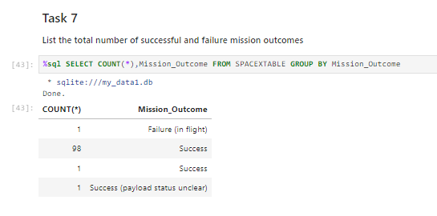
Total Number of Successful and Failure Mission Outcomes
Calculated the total number of successful and failure mission outcomes
Presented query result with a short explanation here

Slide 35
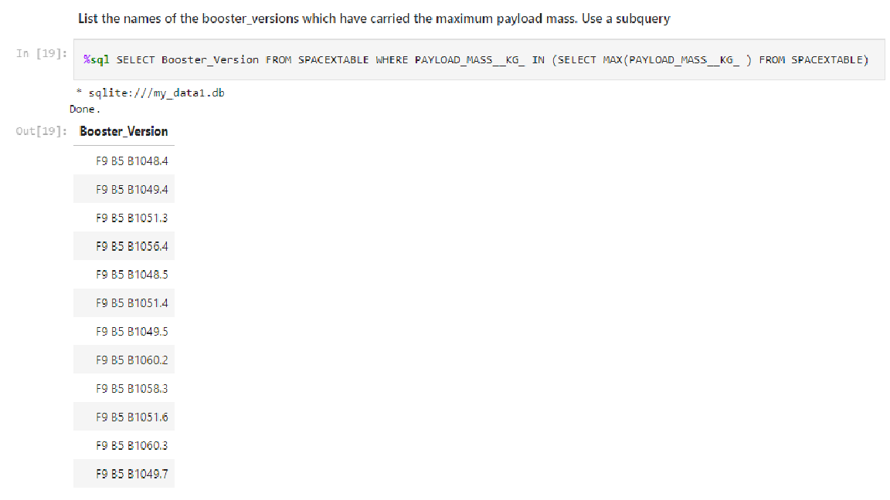
Boosters Carried Maximum Payload
List the names of the booster which have carried the maximum payload mass
Present your query result with a short explanation here

Slide 36
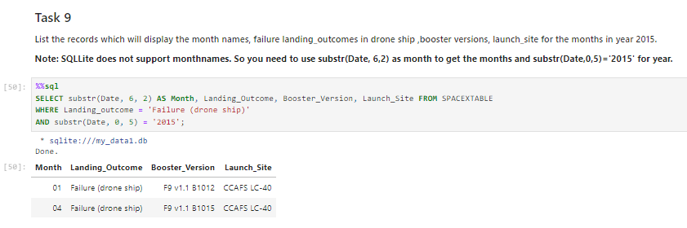
2015 Launch Records
Failed landing outcomes in drone ship, their booster versions, and launch site names for in year 2015
Present your query result with a short explanation here

Slide 37
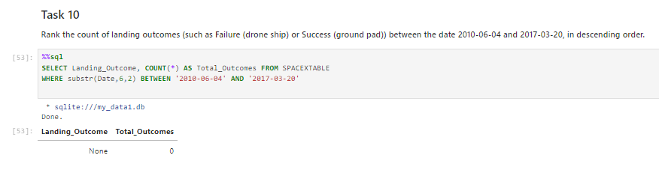
Rank Landing Outcomes Between 2010-06-04 and 2017-03-20
Attempted to rank the count of landing outcomes (such as Failure (drone ship) or Success (ground pad)) between the date 2010-06-04 and 2017-03-20, in descending order
Presented query result with a short explanation here

Slide 38

Section 3

Slide 39
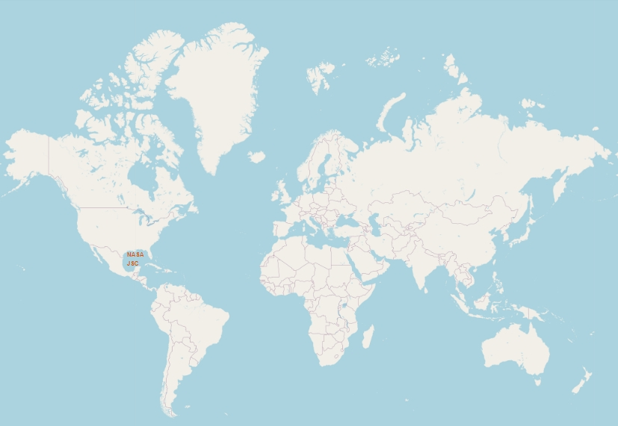
Global Map Showing: Launch Site
Global Map showing Launch Site
Generated folium map and make a proper screenshot to include all launch sites’ location markers on a global map
WE can see a United States launch site

Slide 40
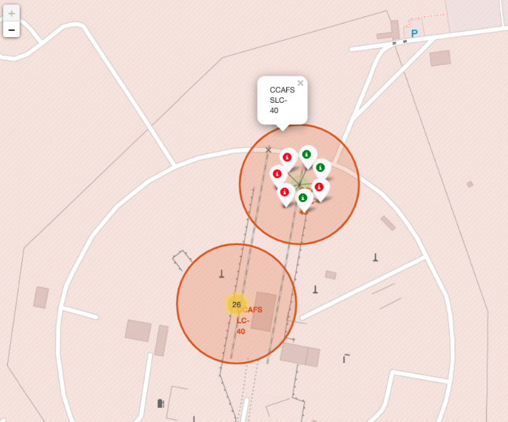
Florida Launch Sites
Title: Florida Launch Sites
Color-labeled launch outcomes on the map: Red: Failures & Green: Success
Important elements and findings on the screenshot

Slide 41

Distance from water and other details
Explore the generated folium map and screenshot of a selected launch site to its proximities such as railway, highway, coastline with distance calculated and displayed
Explain the important elements and findings on the screenshot

Slide 42

Section 4

Slide 43
<Dashboard Screenshot 1>
Replace <Dashboard screenshot 1> title with an appropriate title
Show the screenshot of launch success count for all sites, in a piechart
Explain the important elements and findings on the screenshot

Slide 44
<Dashboard Screenshot 2>
Replace <Dashboard screenshot 2> title with an appropriate title
Show the screenshot of the piechart for the launch site with highest launch success ratio
Explain the important elements and findings on the screenshot

Slide 45
<Dashboard Screenshot 3>
Replace <Dashboard screenshot 3> title with an appropriate title
Show screenshots of Payload vs. Launch Outcome scatter plot for all sites, with different payload selected in the range slider
Explain the important elements and findings on the screenshot, such as which payload range or booster version have the largest success rate, etc.

Slide 46

Section 5

Slide 47
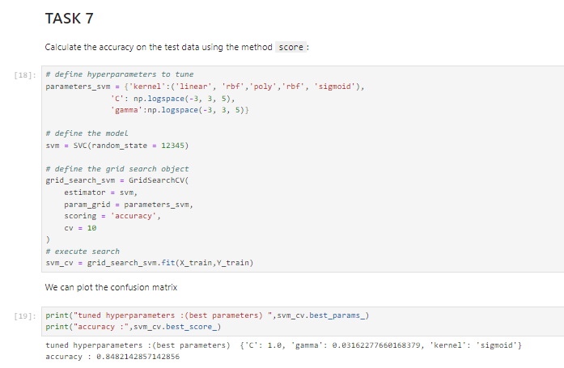
Classification Accuracy
Find which model has the highest classification accuracy

Slide 48
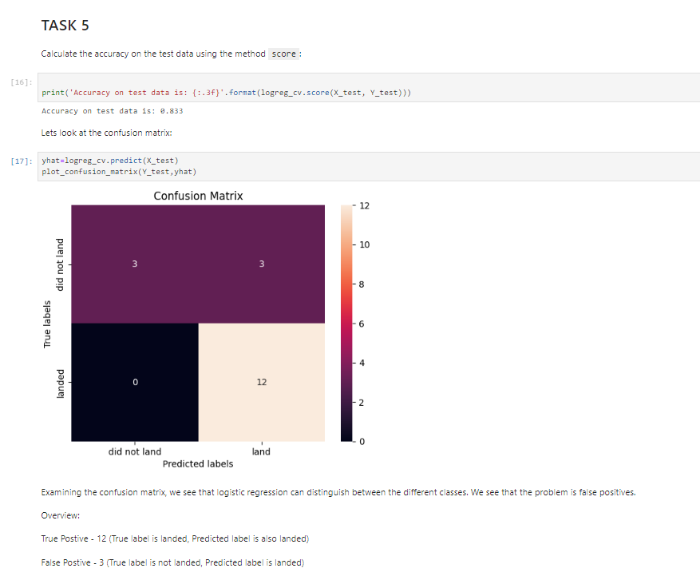
Confusion Matrix
Show the confusion matrix of the best performing model with an explanation
Accuracy of the knn_cv on test data using the method score

Slide 49
Conclusions
The larger the flight amount at a launch site, the greater the success rate at a launch site.
Launch success rate started to increase in 2013 till 2020.
Orbits ES-L1, GEO, HEO, SSO, VLEO had the most success rate.
KSC LC-39A had the most successful launches of any sites.
The Decision tree classifier is the best machine learning algorithm for this task.

Slide 50
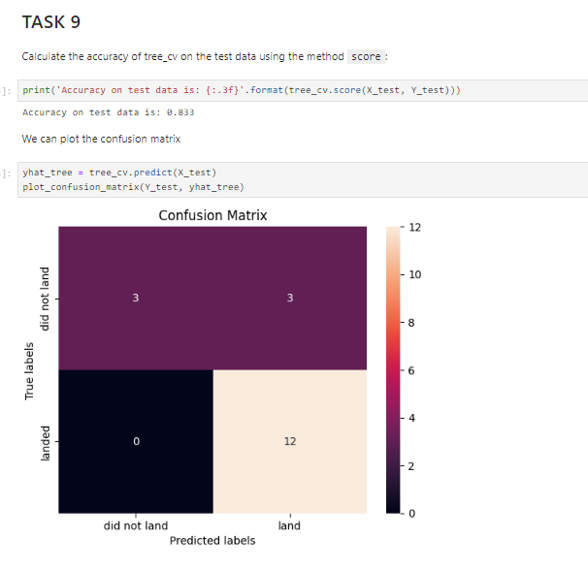
Appendix
Relevant Asset: Confusion Matrix of tree_cv on the test data using the method score

Slide 51


